Slide 1
KANBAN for AGILE TEAMS

Slide 2
INTRODUCTION
Review Concepts for Agile Kanban Teams Usage
Exposure to the Pizza Game as a Learning Tool for Kanban

Slide 3
Objectives
After this session, you should be able to:
Understand principles of Lean product development
Identify team roles, responsibilities, and recommended ceremonies
Describe Kanban and the differences with Scrum
Appreciate the following Kanban element
Visualize work
Limit WIP (work in progress)
Manage flow
Additional resources about Kanban

Slide 4
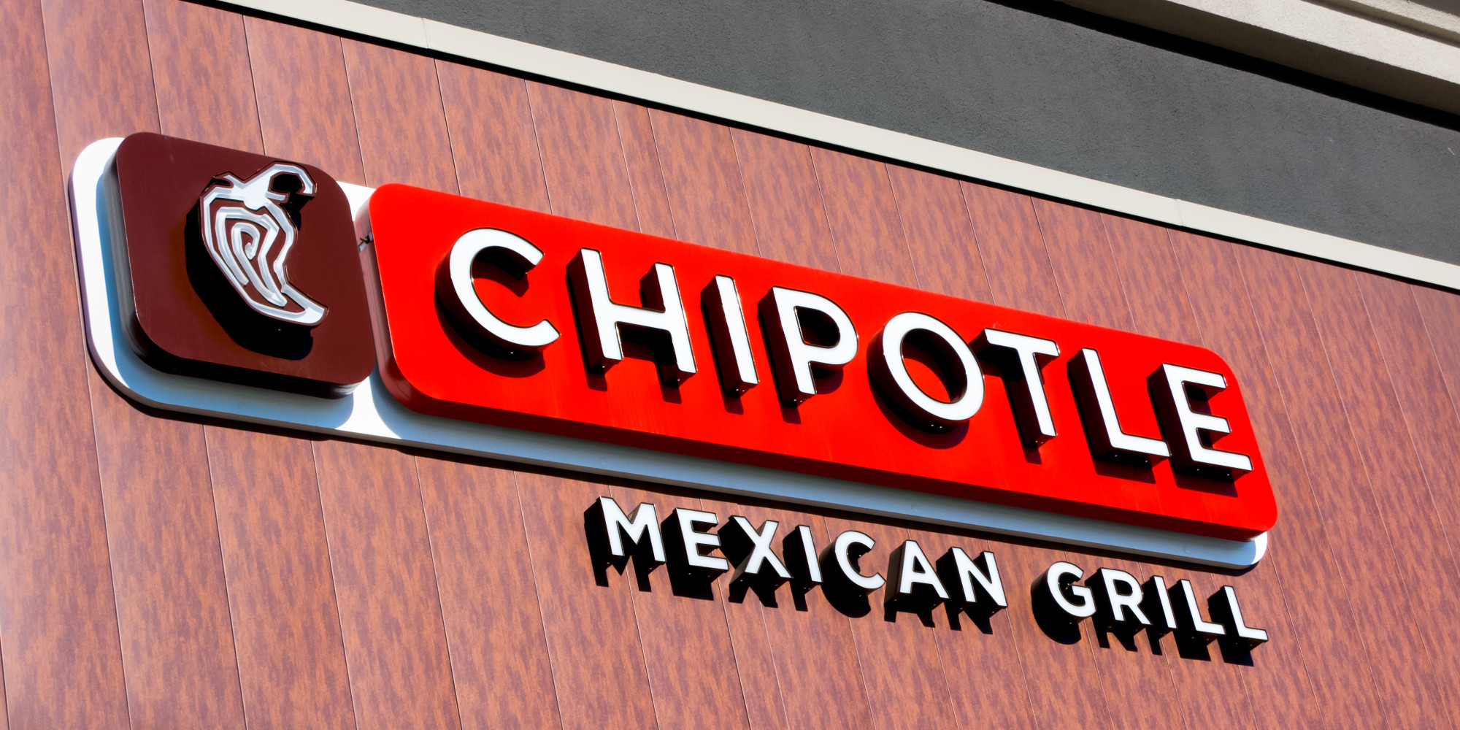
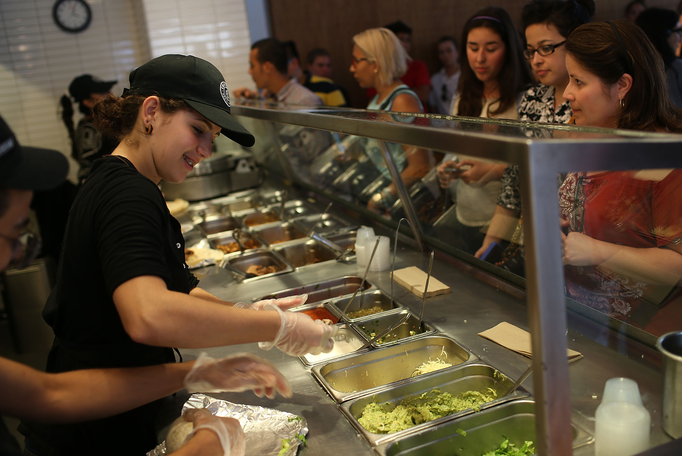
Where Do You See Kanban Today?

Slide 5
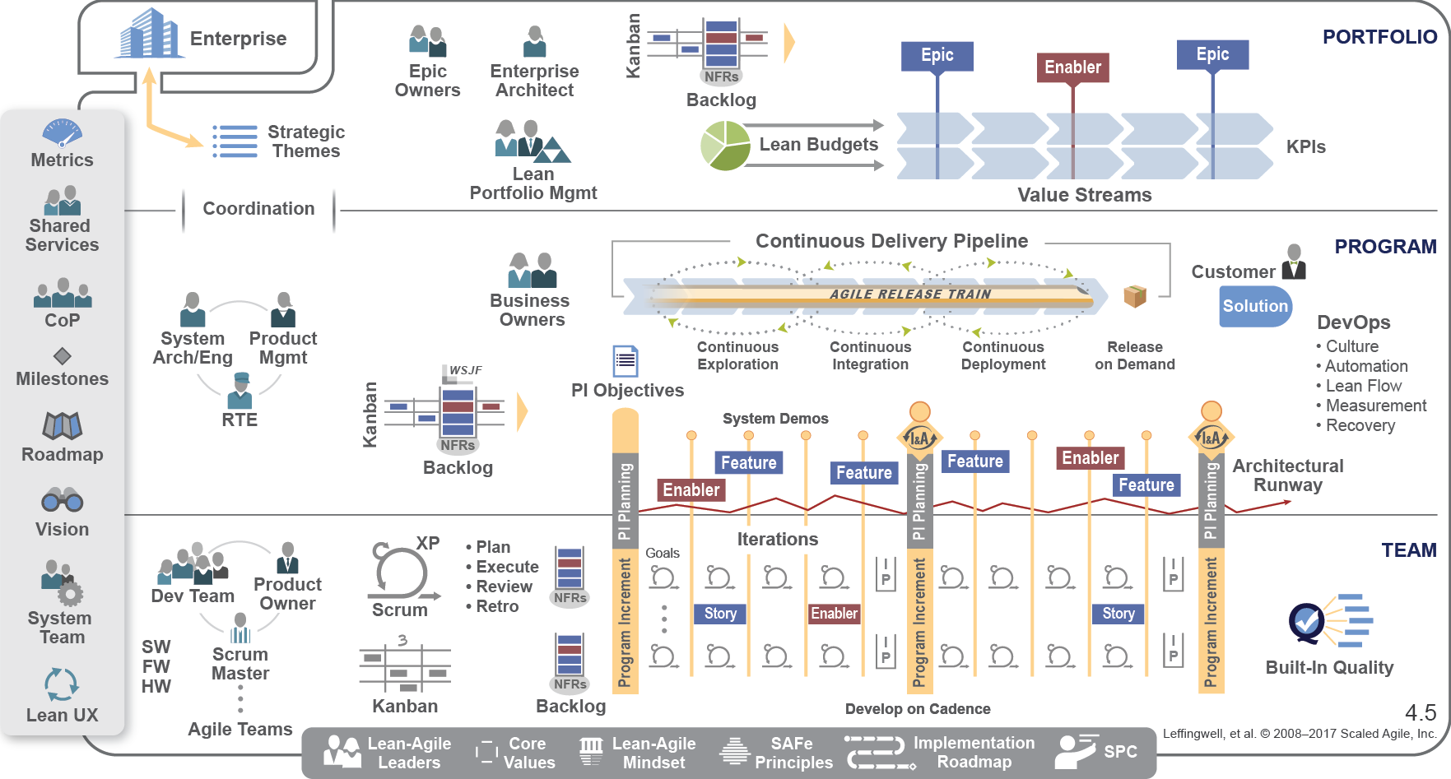
KANBAN in SCALED AGILE

Slide 6
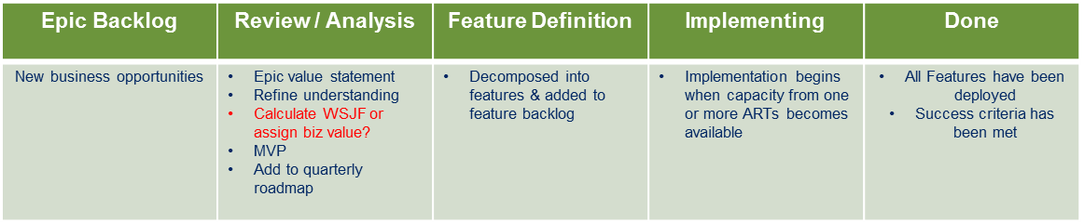
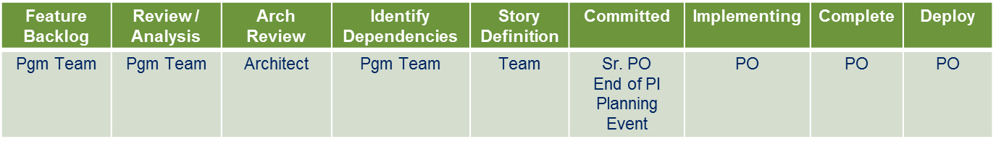
SAMPLE EPIC & FEATURE KANBAN

Slide 7
Agile Manifesto
Individuals and Interactions
Working Software
Customer Collaboration
Responding to Change
O V E R
Processes and Tools
Comprehensive Documentation
Contract Negotiation
Following a Plan

Slide 8
12 Principles of Agile Development
Out highest priority is to satisfy the customer through early and continuous delivery of valuable software.
Welcome changing requirements, even late in development. Agile processes harness change for the customer’s competitive advantage.
Deliver working software frequently, from a couple of weeks to a couple of months, with a preference to the shorter timescale.
Business people and developers must work together daily throughout the project.
Build projects around motivated individuals. Give them the environment and support they need and trust them to get the job done.
The most efficient and effective method of conveying information to and within a development team is face-to-face conversation.
Working software is the primary measurement of progress.
Agile processes promote sustainable development. The sponsors, developers, and users should be able to maintain a constant pace indefinitely.
Continuous attention to technical excellence and good design enhances agility.
Simplicity – the art of maximizing the amount of work not done – is essential.
The best architectures, requirements, and designs emerge from self-organizing teams.
At regular intervals, the team reflects on how to become more effective, then tunes and adjusts its behavior accordingly.

Slide 9
Lean Origins
1913 – Henry Ford industrializes Just-In-Time(JIT) manufacturing system
1949 – Taiichi Ohno creates the Toyota Production System (TPS)
1990 – James Womack coined the term “Lean Manufacturing”
2003 – Mary and Tom Poppendieck adapt Lean Manufacturing principles into Lean Software Development

Slide 10
7 Principles of Lean Software Development
Eliminate Waste
Seeing Waste, Value Stream Mapping
Amplify Learning
Feedback, Iterations, Synchronization, Set-Based Development
Decide as Late as Possible
Options Thinking, Last Responsible Moment, Making Decisions
Deliver as Fast as Possible
Pull Systems, Queuing Theory, Cost of Delay
Empower the Team
Self-Determination, Motivation, Leadership, Expertise
Build Integrity In
Refactoring, TDD, Automation Testing, Minimizing Manual Testing Effort
See the Whole
Measurements, Board, Transparency, Portfolio Connectivity, SOS Participation
-Source Mary & Tom Poppendieck Lean Software Development: An Agile Toolkit

Slide 11
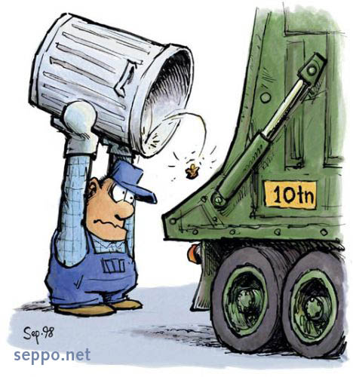
MUDA – The Seven Wastes of Lean Software Development
Partially Done Work
Extra Features
Relearning
Hand-offs
Delays
Task Switching
Defects

Slide 12
What Is Kanban?
Means
billboard or sign
in Japanese
Agile
Lean
Lightweight

Slide 13
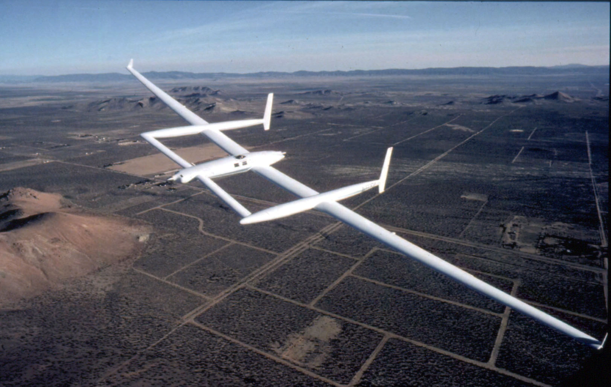
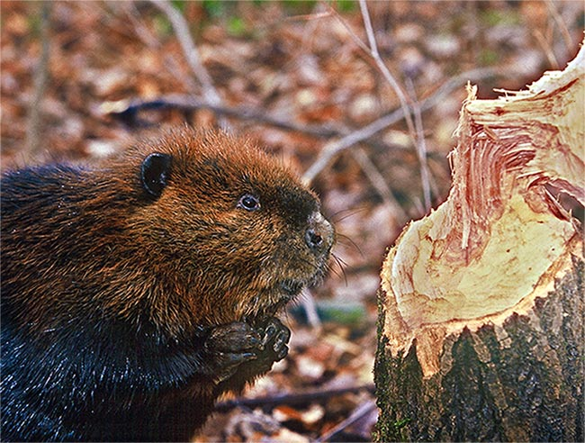
Kanban for Agile Teams
Focus on efficiency
Rutan Voyager

Slide 14

Recommended Kanban Roles
From an Agile Organizations perspective:
Product Owner
Team (4-6 members)
Facilitator – Rotating role from within the team

Slide 15

Roles and Responsibilities of Product Owner
Owns Backlog of work items for the team
Ensures the work items meet the “definition of ready”
Grooms the backlog ensuring proper prioritization
Meets with stakeholders who may have competing priorities
Accepts work items are ready for production (when appropriate)

Slide 16
Roles and Responsibilities of TEAM
Cross functional capabilities as expected for Agile Teams
Define Kanban Board States (workflow)
Decide WIP Limits
Define Exit Criteria (similar to Definition of Done) for each Kanban State
Most important, they SWARM more often then Flying Solo

Slide 17

Roles and Responsibilities of Facilitator
Guides the team in the skillful use of the Kanban framework
Organizes and attends team meetings, resolving conflicts in the team, removes impediments in the team, and manages external dependencies
Empowers the team to make decisions
Ensures close collaboration and communication across all roles and functions including external SME’s
Communicates progress and status to all internal stakeholders
Enforces the following of team agreement and best practices
Can be rotated through the team

Slide 18
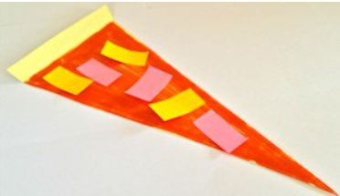
Experiencing Kanban
Hawaiian Pizza
A slice of pizza base (paper triangle)
Tomato sauce (red marker)
Three slices of ham (pink post-its)
Three slices of pineapple (yellow post-its)
The tomato sauce covers the pizza bottom nearly completely and the toppings are carefully cut and distributed evenly across the pizza
YUM!
From agile42.com

Slide 19
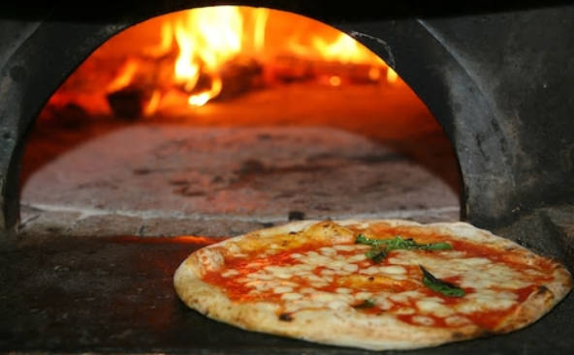
Experiencing Kanban
Oven Plate
Max three (3) pizza slices in the oven at one time
Cooking time is at least 30 seconds
No adding or removing slices while baking
From agile42.com

Slide 20
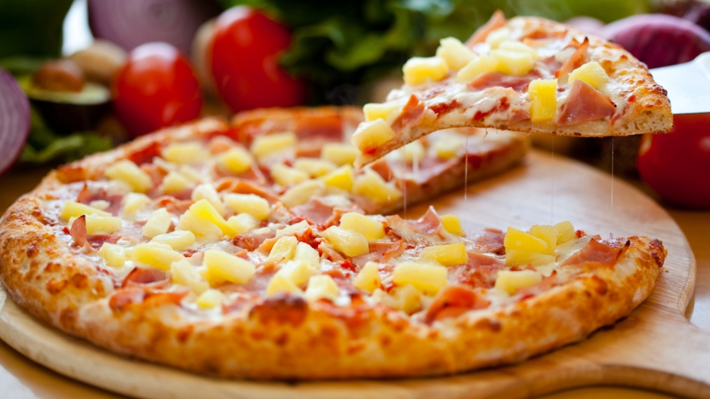
PLAY!
ROUND 1
create an implicit process

Slide 21
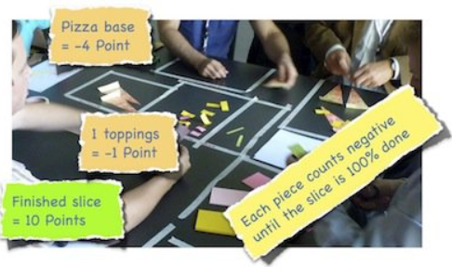
POINT SYSTEM TO MEASURE & OPTIMIZE FLOW

Slide 22
KANBAN PRACTICES
Visualize Work
Limit Work in Progress (WIP)
Manage Flow

Slide 23
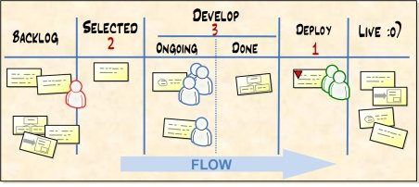
VISUALIZE WORKFLOW AND LIMIT WIP
FOUR KEY ASPECTS TO THE KANBAN BOARD/TEAMS
Visual / Transparent
FLOW – Keep work items moving left to right
PULL – Work items are pulled into the succeeding stage not pushed
WIP – Work In Progress – Keeps focus on the right things at the right time

Slide 24
Defining Work In Progress Limit
Key attribute of Kanban to ensure resources are being applied at the right area of the workflow
It reinforces Lean’s- Just In Time (JIT) behavior which leads towards efficiency

Slide 25
Work In Progress Limit
Key attribute of Kanban to ensure resources are being applied at the right area of the workflow
It reinforces Lean’s- Just In Time (JIT) behavior which leads towards efficiency
Used to ensure that work load doesn’t exceed the teams capacity limit.
It is the MAXIMUM items that should be current in a given state or states.
Guidelines
WIP should be 2X the number of team members who can work on items in that state.
Can range anywhere from 1 to ∞
Done/Deployed/In Production would typically be set to Infinity

Slide 26
Exit Criteria
This provides a guideline or “Must Have” checklist of what needs to be in completed to a work item on the Kanban Board to be marked “READY” to be pulled into the next state
The benefit is team consensus and understanding for what are the pre-requisite criteria needed before work can begin on a work item being pulled into another state.

Slide 27
Defining Initial Kanban Board
Discuss and examine current workflow process
Challenge the team to create simple Kanban board mirroring your flow
Encourage the team to modify the board as needed over time
Reinforce the agile mindset of teamwork vs. individuals
If the board resembles waterfall, discuss again with the team and their leaders if they are ready to commit to Kanban at this time
i.e. Backlog, Define, Develop, Test, Retest, Bug Fix, Retest, Deploy
For each State of the Kanban board specify:
WIP – Work in Progress limit
Exit Criteria for each state
Being Fast and Busy doesn’t mean you are efficient

Slide 28
PLAY!
ROUND 2
visualize flow and limit WIP

Slide 29
STOP!!! LET’S MEASURE THE POINTS!

Slide 30
Recommended Kanban Ceremonies
Daily Kanban
Max 15 minute time box
Everyone stands
Same time and place each day
Everyone briefly presents
What they did since the last Daily Kanban to keep work items moving through the board
What they plan on doing today to keep work items moving through the board
What new impediments that is preventing work from flowing through the board
Retrospectives
Team discusses what changes they should make to improve their Kanban teams efficiency and quality
High Frequency to Less Frequent
Week 1 – Daily; Week 2, Every Other day; Week 3 – Every third Day; Ongoing – Every 2 weeks
Encourage the team to experiment, modify toward efficiency within best practices

Slide 31
NEW PIZZA AND CUSTOM ORDERS
Arugula pizza
A slice of pizza base (paper triangle)
Tomato sauce (red marker)
7 pieces of arugula (green post-it)
Arugula burns in the oven, so it needs to be applied after cooking
Custom Orders
Will be displayed on the screen
Orders dropped off at delivery terminal
Points given only for fully delivered orders in the order of request.

Slide 32
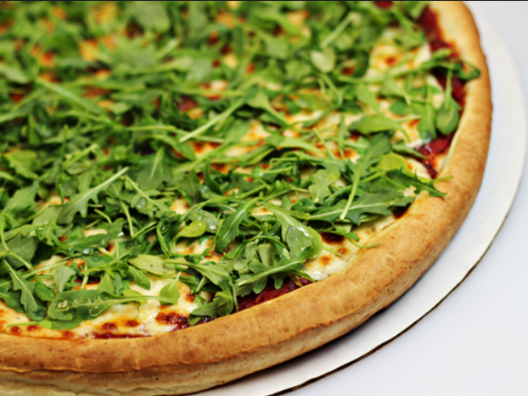
PLAY!
ROUND 3
Custom Orders

Slide 33
PLAY!
ROUND 3
Custom Orders
Order 1: Two Arugula
Order 2: One Hawaiian
Order 3: One Hawaiian + Two Arugula
Order 4: Four Arugula
Order 5: Two Hawaiian + One Arugula
Order 6: Four Hawaiian
Order 7: One Hawaiian + Three Arugula

Slide 34
STOP!!! LET’S MEASURE THE POINTS!

Slide 35
PLAY!
ROUND 4
Custom Orders
Order 1: Three Arugula
Order 2: One Hawaiian + One Arugula
Order 3: One Hawaiian + Two Arugula
Order 4: Four Arugula
Order 5: One Hawaiian + Two Arugula
Order 6: Three Hawaiian
Order 7: One Hawaiian + Two Arugula

Slide 36

REFLECT and ADJUST

Slide 37
STOP!!! LET’S MEASURE THE POINTS!

Slide 38
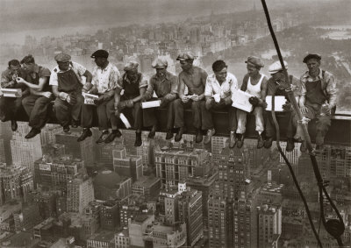
LET’S TAKE A QUICK BREAK

Slide 39
Establishing Kanban Teams
Assess
Work the group currently performs and needs to perform
Team member composition
Manner to define Kanban board and metrics tracking
Manual
Systemic (JIRA, TRELLO, Others)
Establish team working agreements
Discuss the value of working as a team vs a group of individuals

Slide 40
Defining Initial Kanban Board
Create States as Simple and as Agile as Possible
Guide the group to be an Agile Team not a Busy Team
Don’t restate the current process, emphasis team swarming
Apply Swim lanes sparingly – Expediate for Ultra-Urgent work items
Define Exit Criteria for Each State
Definition of when work items in that state may be marked as “Ready to be Pulled” into the next state; NOT PUSHED FORWARD
Stress keeping the exit critieria
Simple
Evolving

Slide 41
Defining Initial Kanban Board
Apply WIP limits for Each State(s)
Don’t exceed 2x number of team members available for those states
“Multitasking Makes You Stupid. Doing more than one thing at a time makes you slower and worse at both tasks. Don’t do it. If you think this doesn’t apply to you, you’re wrong—it does.”
― Jeff Sutherland, Scrum: The Art of Doing Twice the Work in Half the Time
Discuss the States where Cycle Time clock begins and ends
Typically this will be between when development begins and work item is ready to be placed into production or is in production

Slide 42
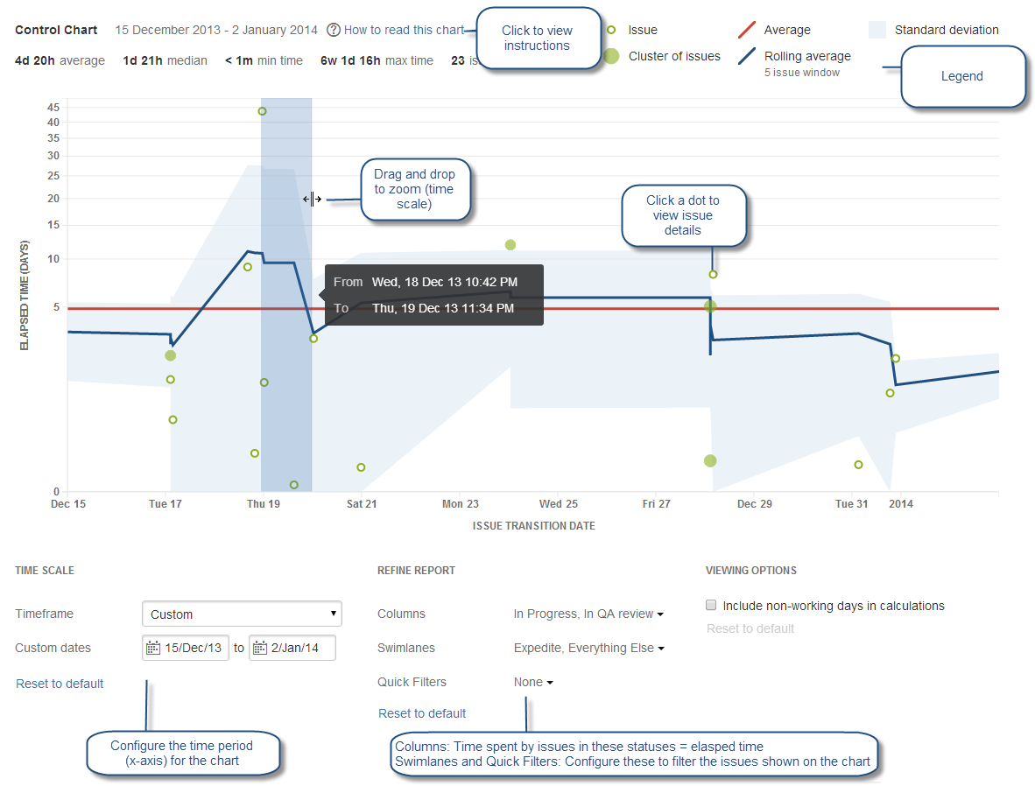
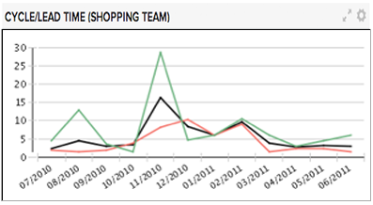
KANBAN METRICS: Cycle Time
Cycle Time - the amount of time the Team worked on a work item over a given interval. Value add time spent changing form, fit, function of something that customer desires.
Low cycle times are preferable over high cycle times.
Excellent metric to for a team to measure their performance trends.
Typically measured when the team commits to doing the work (i.e. Development state) & when the work completes (i.e. Accept or Done state).
Usually measured by an average over a given interval (week, month, quarter).
Different than Lead Time, which starts before team commitment.
Delays to deploy product may be exempt from the Cycle Time calculation.

Slide 43
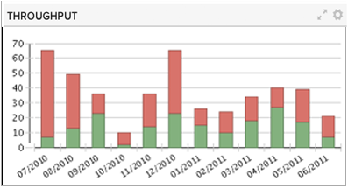
KANBAN METRICS: Throughput
Throughput- Number of work items that have reached the final Kanban state over a given interval.
Quality TRUMPS Throughput
High Throughput counts are preferable over Low Throughput counts.
Excellent metric to for a team to measure their performance trends.
Usually measured by an average over a given interval (week, month, quarter).

Slide 44
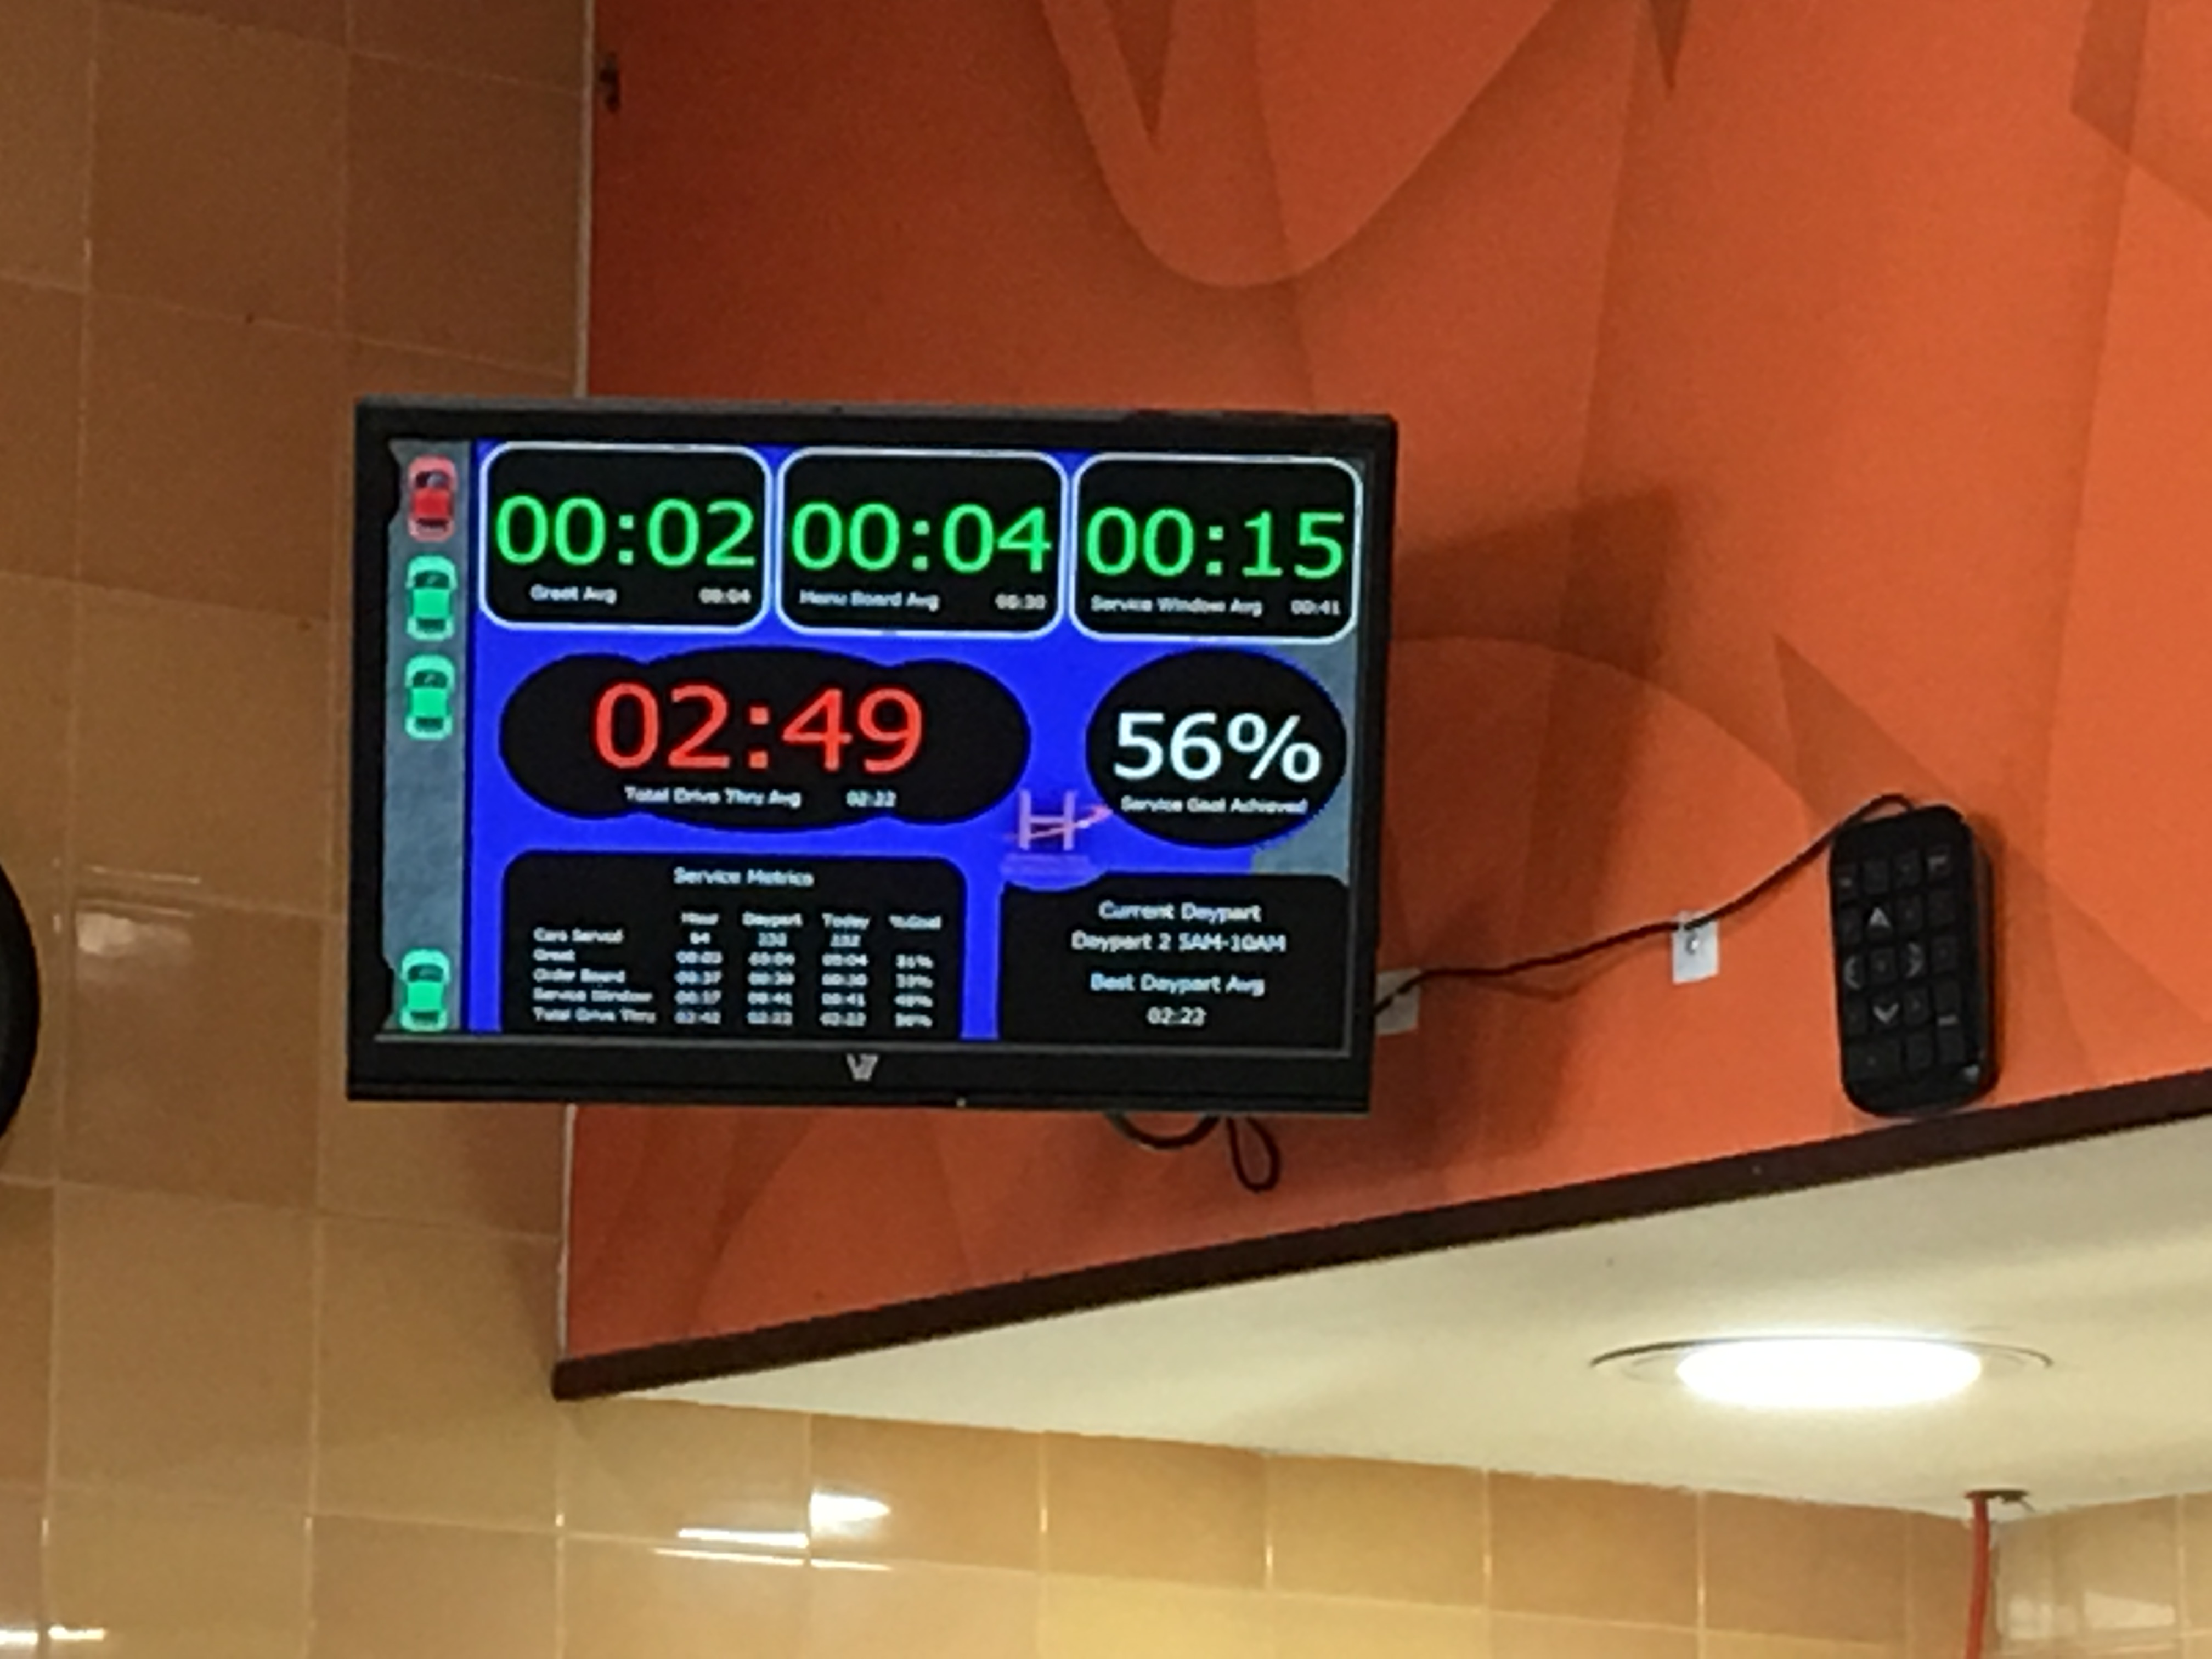
Cycle Time @ Dunkin Donuts

Slide 45
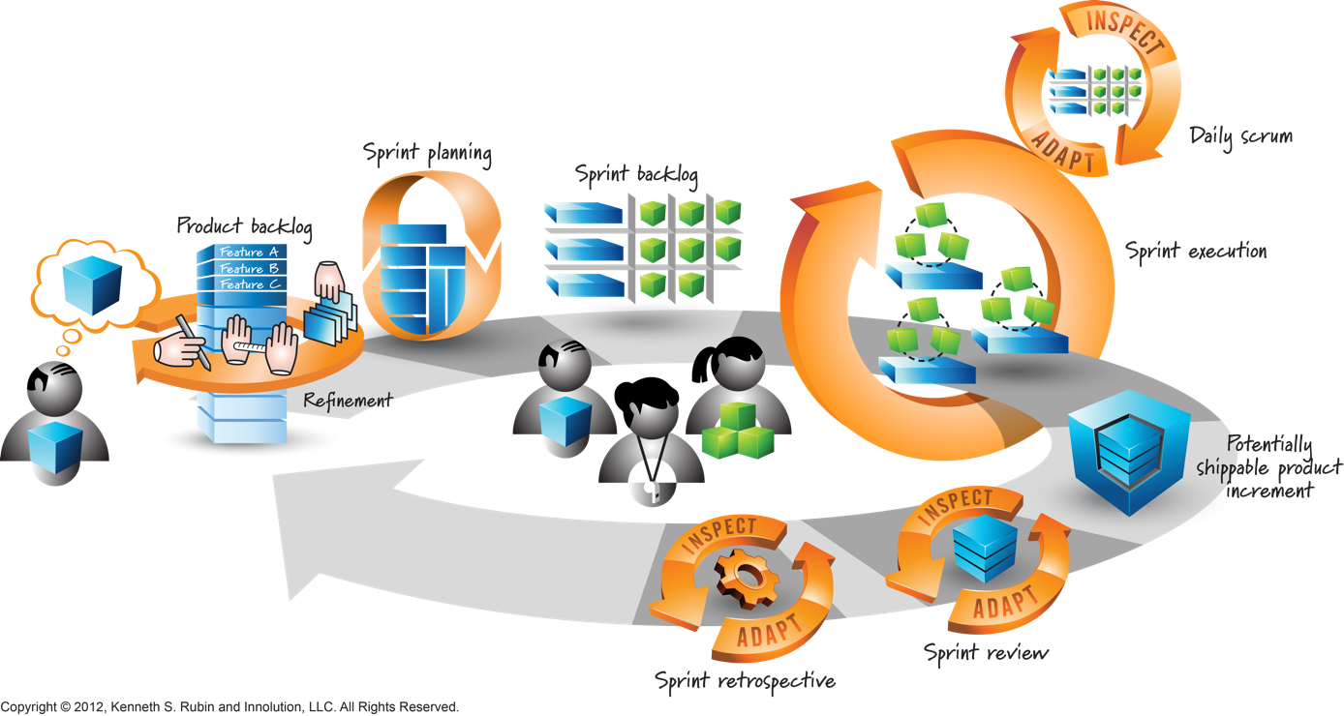
NEXT CLASS: SCRUM!

Slide 46
Think Kanban,
Be Agile!

Slide 47
Additional Resources
PODCASTS:
This American Life Podcast about GM & Toyota Production System Joint Venture, and What Came of It
Books:
Toyota Production System: Beyond Large Scale Production, Taiichi Ono
Lean Software Development, Mary & Tom Poppendieck
Kanban: Successful Evolutionary Change for Your Technology Business, David J. Anderson
The Goal: The Process of Ongoing Improvement, Eliyahu Goldratt

